Slide 1

Current-See
See what your converting!
Ever wonder what the currency you converting looks like?
Now you can with Current-See!
Princeton To

Slide 2

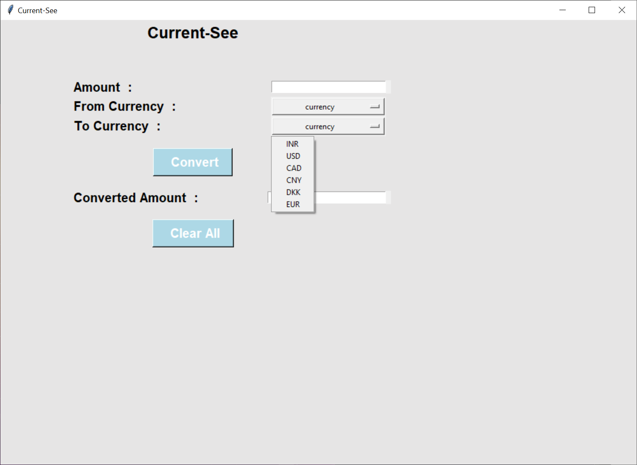
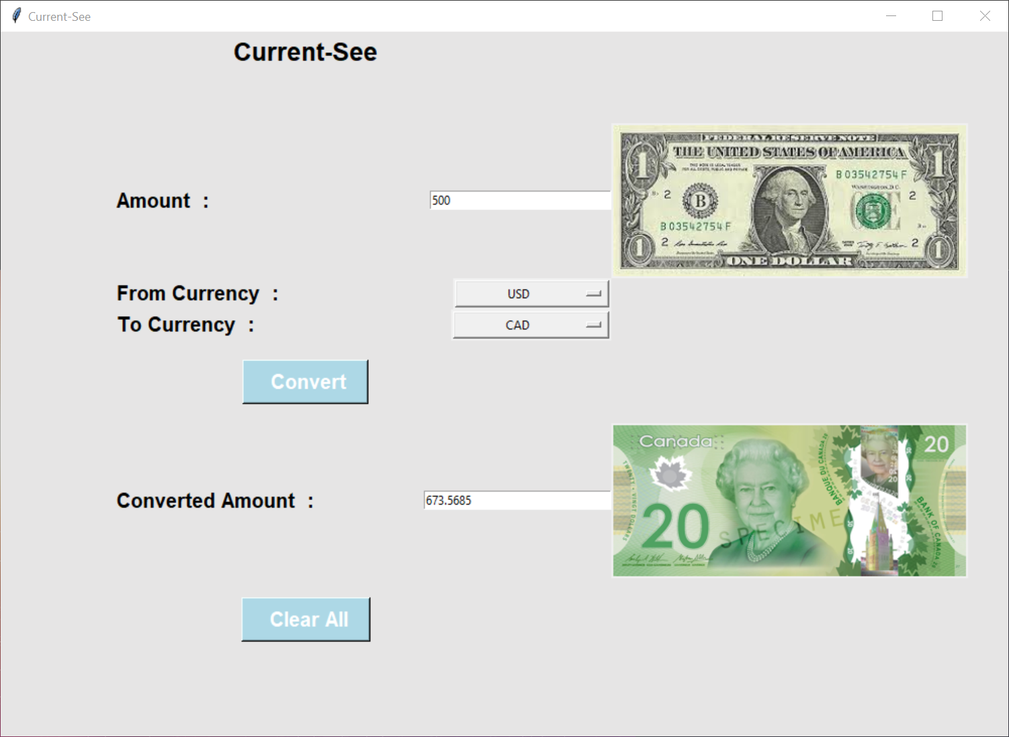
[
Features an easy-to-use interface with images of what the currency looks like!
[
Conversions available for the Indian Rupee, USD, Canadian Dollar, Chinese Yuan, Danish Krone, and the Euro!

